Slide 1
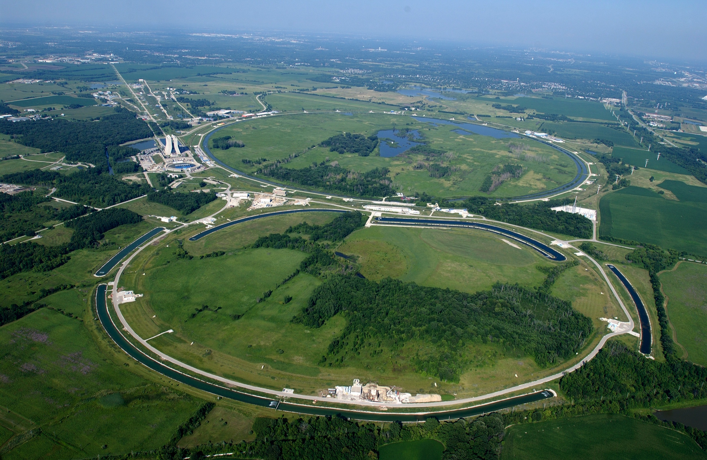
Measurement of the Quenching Factor for Barium Fluoride Crystals
Ariel Hasse ~ Caltech Class of 2019
Mentor ~ David Hitlin
Fermilab Particle Accelerator outside of Chicago. Source: https://upload.wikimedia.org/wikipedia/commons/3/3f/Fermilab.jpg

Slide 2
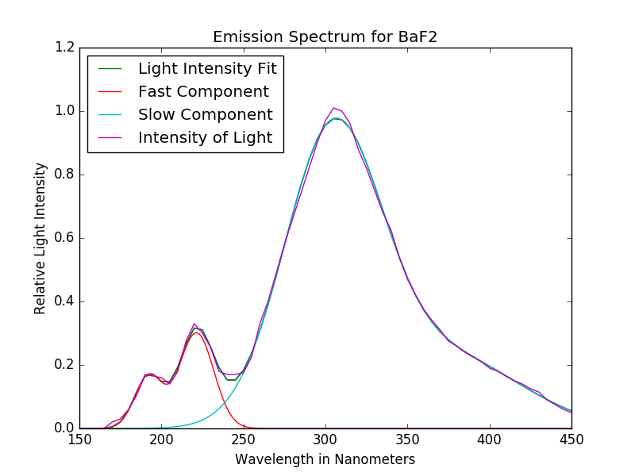
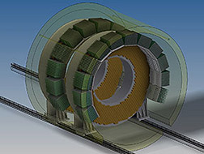
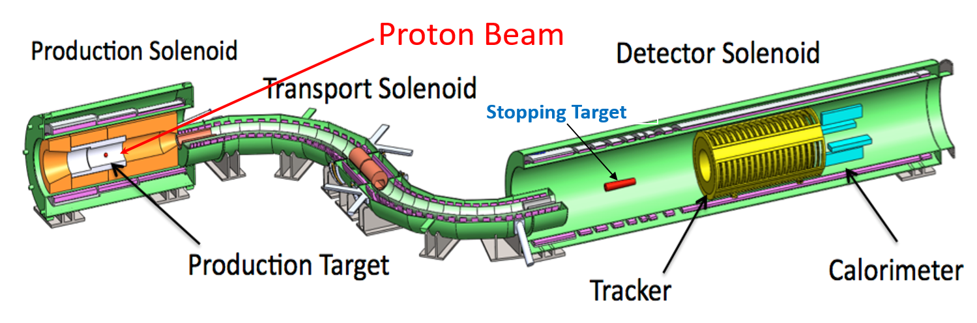
Scintillation and Crystals
Calorimeters can be made of Inorganic Crystals, like BaF_{2.}
A scintillator is a material that excites photons when a particle deposits energy.
BaF₂ has two mechanisms of scintillation; known as the fast (.6 ns) and slow (620 ns) components. The fast component is relevant to accelerators
Emission Spectrum from manufacturer specification. Source: Ariel Hasse, Hitlin’s Lab, Caltech
Sketch for Mu2e Calorimeter. Source: http://mu2e.fnal.gov/public/project/reviews/images/Mu2e_Calo.jpg
Sketch for 2020 Mu2e Beam on Fermilab. Source: http://mu2e.phy.duke.edu/

Slide 3
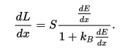
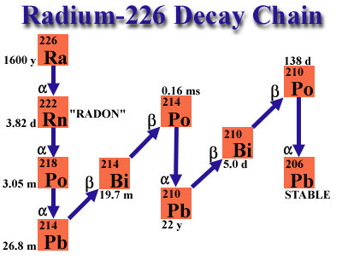
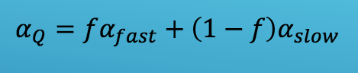
Quenching Factor
The Differential Version of Birk’s Law. Source: https://en.wikipedia.org/wiki/Birks%27_Law
Birk’s Law was created by J.B. Birk’s in 1964. It is considered to apply to all scintillators.
Energy is lost as particles travel through the crystal, however the scintillation light produced is not completely linear with energy deposition. This is described by kb, also known as the Quenching Factor.
Birk’s Constant (Quenching Factor)
The Four Alpha Decays from the natural Radium impurity in BaF₂. Source: http://en.allexperts.com/q/Nuclear-Power-2462/2013/5/ra226.htm
In this experiment we use gamma and electron sources to calibrate BaF_{2.} The calibration allows us to find the quenching factor for alpha sources.
Quenching Factor components. Source: Hallman Gestsson, Hitlin’s Lab, SURF Caltech

Slide 4
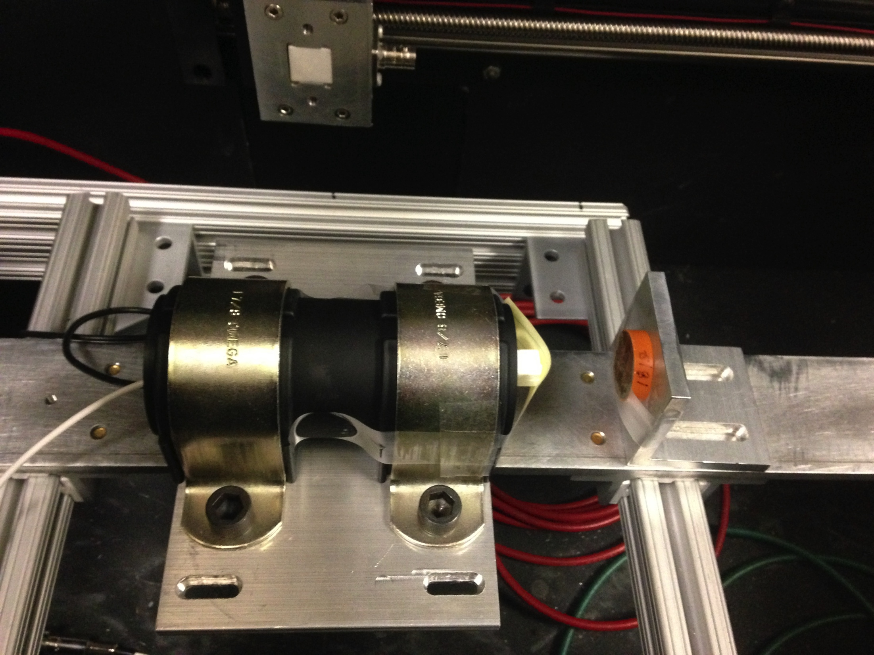
Experimental Configuration
The voltage generator powers the Photomultiplier Tube (PMT) and it sends energy values to the Caen data compiler.
Changing the voltage varies how the channels are spaced. So for each PMT for every source the voltage must be the same.
Solarblind PMT set-up with crystal and Na 22. Source: Ariel Hasse, Hitlin’s Lab, Caltech
We are using five sources; Cesium 137, Sodium 22, Americium-Beryllium 241, Cobalt 60, and Radium 226 which is a natural impurity in BaF_{2.}
Schematic Diagram of Set- up.
Source: Ariel Hasse, Hitlin’s Lab, Caltech
Light Sealed Box
Source
(Opt.)
PMT
BaF₂
Computer
Voltage
Supply
Caen; Data
Compiler
Temperature
Probe

Slide 5
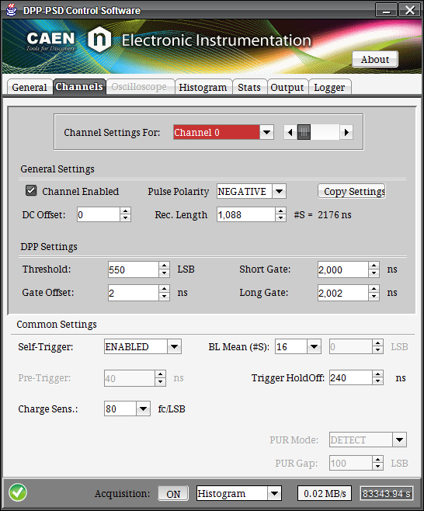
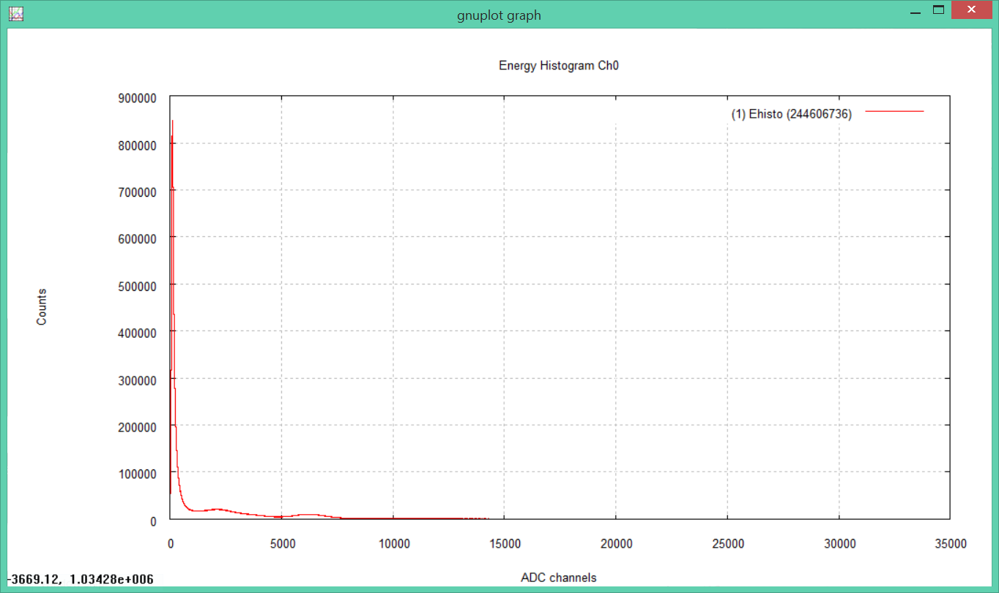
Data Collection
The Binning size is in femto-coulombs/LSB. This is set depending on the strength of the source and the voltage. The threshold and gate length in part determine the number of counts.
The channels on the x-axis represent an energy value based on binning, the source, the PMT, and the voltage.
The position of the peaks is the energy of the decaying source.
Energy histogram on monitor display. Source: Ariel Hasse, Hitlin’s Lab, Caltech
Caen interface on a desktop. Source: Ariel Hasse, Hitlin’s Lab, Caltech

Slide 6
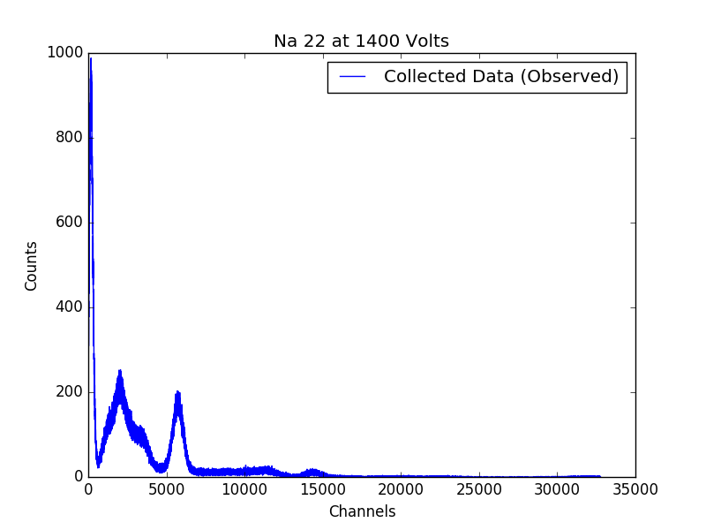
Python Data Analysis
The txt file with the channel and count can graph the desired peaks. Using the optimize function the data is minimized to fit a Gaussian and outputs the parameters. Another function plots the best fit for visual analysis.
First Peak
(511 keV)
Second Peak
(1274 keV)
Na 22 Plotted Measured Data. Source: Ariel Hasse, Hitlin’s Lab, Caltech
The Arduino circuit board and AM2302 sensors record the temperature of the lab every ten minutes. My program can also analyze that data for fluctuations.
This pipeline is well documented and publicly accessible and could be used for further experiments.

Slide 7
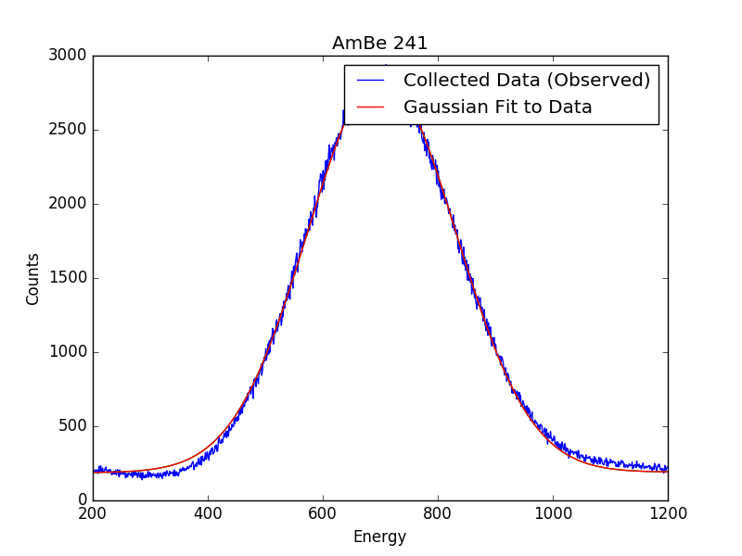
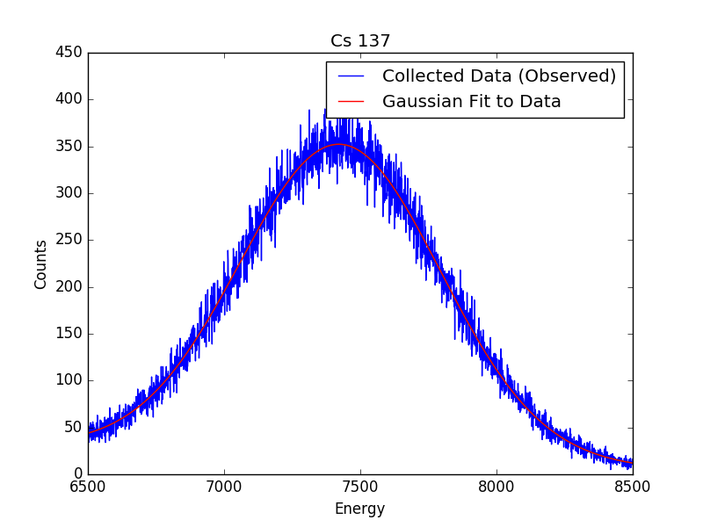
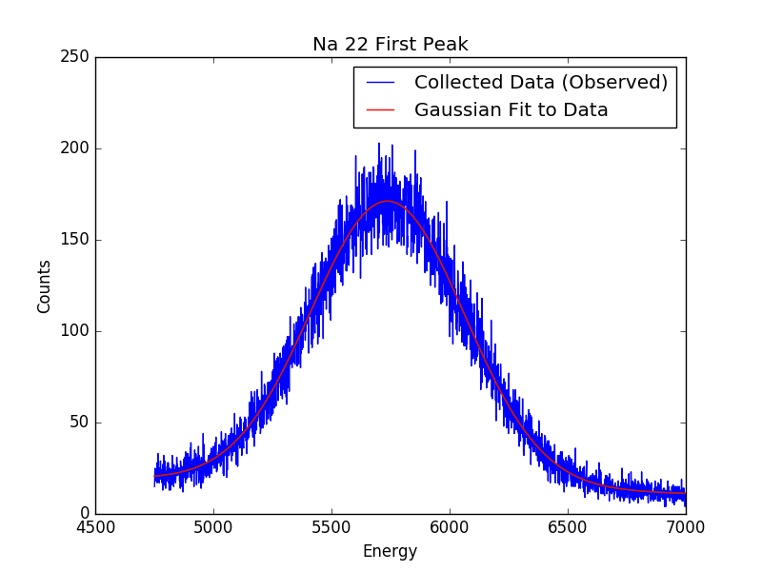
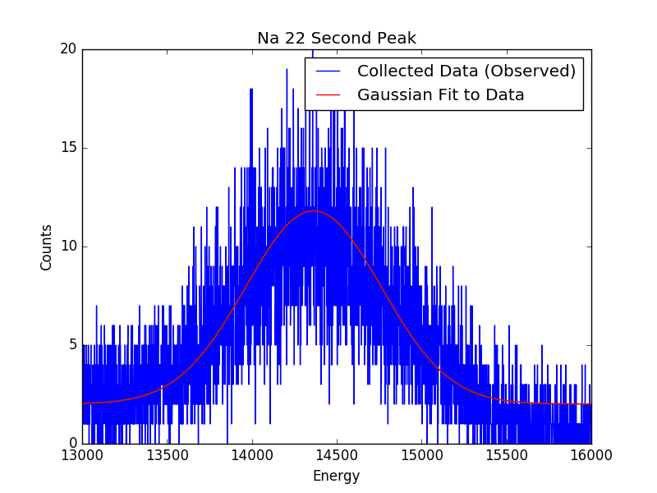

Slide 8
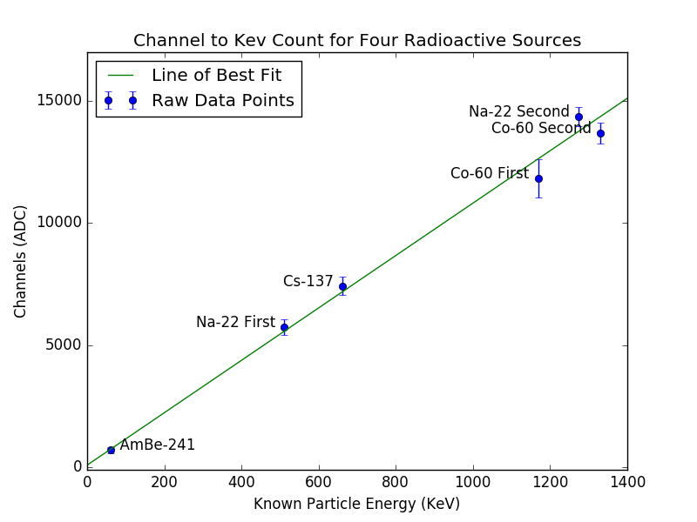
Calibrating the Crystal
These values have been experimentally determined and are used to find the conversion between channel and keV for the specific PMT and voltage.
Conversion Factor for light mass particles. Source: Ariel Hasse, Hitlin’s Lab, Caltech
Thus far this has been done for the UV Extended Full spectrum PMT at 1400 volts.
Source | Cs 137 | Na 22 First Peak | Na 22 Second Peak | Co 60 First Peak | Co 60 Second Peak
Energy (keV) | 662 | 511 | 1274 | 1170 | 1330
We only use the gamma and electron sources for this factor since they are decays of similar mass.
Source | AmBe 241 | Ra 226 First Peak | Ra 226 Second Peak | Ra 226 Third Peak | Ra 226 Fourth Peak
Energy (keV) | 59 | 4800 | 5500 | 6000 | 7700
Known Energy Values. Source: See Reference Slide

Slide 9
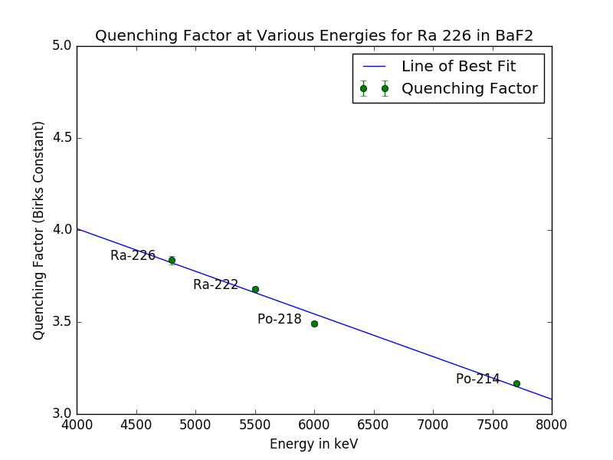
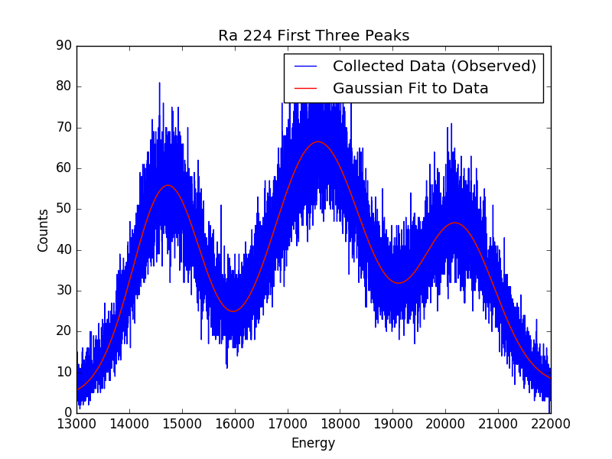
Quenching Factor
Recall the four Radium peaks are 4800, 5500, 6000, and 7700 keV. The first three are fitted below.
Quenching Factors: [3.83, 3.68, 3.49, 3.16]
The Quenching Factor for this PMT at this voltage with the Barium Fluoride crystal is shown as a linear function. It is predictable as a function of energy decay for alpha particles
Radium 226 Quenching Factor (above) and Gaussian Fits (below). Source: Ariel Hasse, Hitlin’s Lab, Caltech

Slide 10
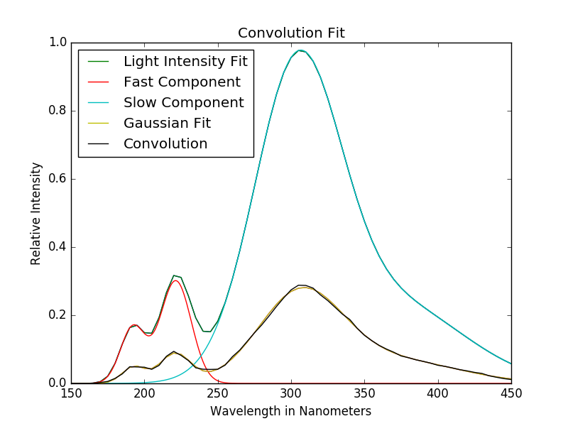
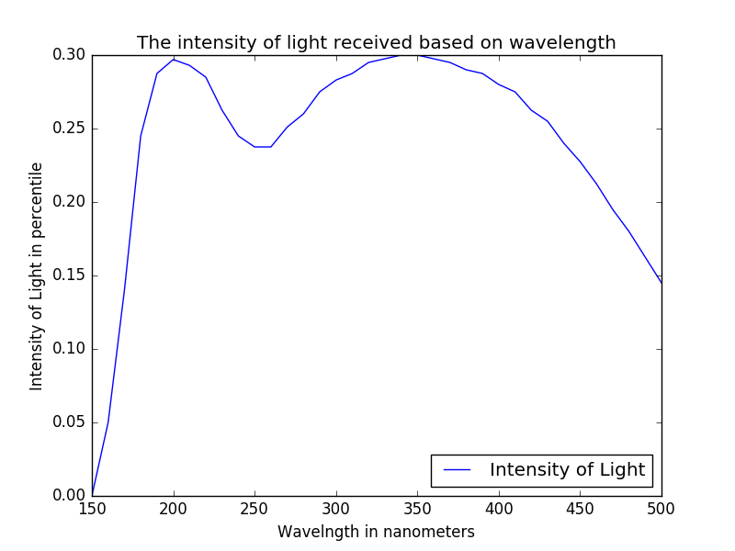
Each PMT has a different Quantum Efficiency (QE) for varying wavelengths of light. The convolution of the BaF₂ spectrum (shown previously) and the QE for the PMT determine the ratio of fast and slow components
The previous process is conducted for three PMTs; UV Extended Full Spectrum, Solarblind, and UV Extended Full Spectrum with shortpass filter.
Quantum Efficiency for the UV Extended Full Spectrum PMT convolved with the Emission Spectrum for Barium Flouride showing the fast and slow components. Source: See References; Ariel Hasse, Hitlin’s Lab, Caltech

Slide 11
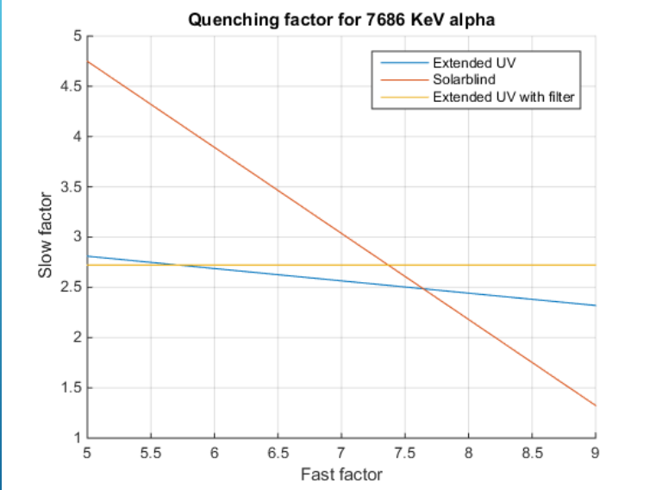
Final Quenching Factor
The ratio of fast and slow components determines the quenching factor. This ratio is a value that can be used for the quenching factor for BaF₂ with any PMT for alpha sources.
The Quenching Factor is the point of best fit between the three lines intersection
This is the Quenching Factor fit from last years SURF student. I am in the process of collecting this data for my research.
Source: Hallman Gestsson, Hitlin’s Lab, SURF Caltech

Slide 12
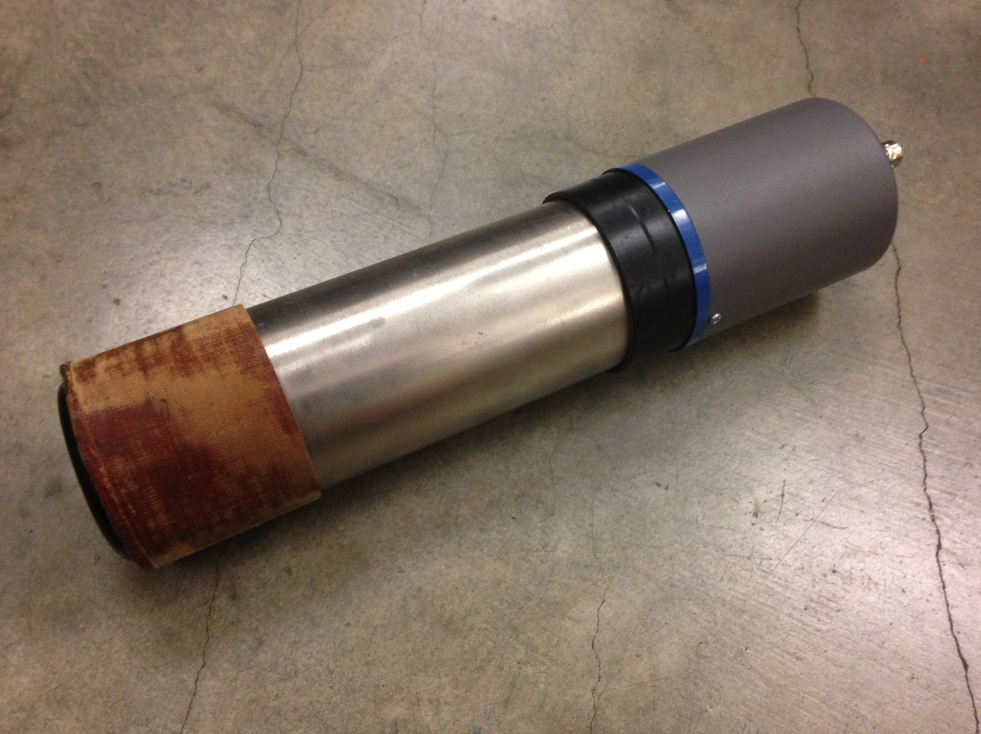
Ongoing Research
Currently data is being collected with the Solarblind PMT at 2170 volts. I will also repeat this process for the UV Extended Full Spectrum with the shortpass filter.
The final quenching factor and subsequent data on BaF₂ crystals with many PMTs will be useful in high energy particle physics
Lastly analysis on the physics mechanism will be conducted.
Solarblind PMT set-up in light sealed box (top) and UV Extended Full Spectrum (bottom). Source: Ariel Hasse, Hitlin’s Lab, Caltech

Slide 13
References
(Photo credit given where image appears in presentation)
Birks, J.B. (1964). The Theory and Practice of Scintillation Counting. London:
Pergamon.
Polischuk, O., Belli, P., Bernabei, R., Capella, F., Caracciolo, V., Cerulli, R., . . . Tretyak, V. (2009). Radioactive contamination of BaF2 crystal scintillator. Nuclear Institute.
Balantekin, A. B., et. al. IOP Publishing. Journal of Physics G: Nuclear and Particle Physics. Volume 37 Number 7A Article 075021; July 2010. Detectors at accelerators; pages 305, 306, 320, and 321.
Bartosvek, L., et. al. Fermi National Accelerator Laboratory. Mu2e Technical Design Report; October 2014. Project Overview; pages 2-1 and 2-15 to 2-18, Muon to Electron Conversion; pages 3-1 to 3-3, Calorimeter; pages 9-1 to 9-39.

Slide 14

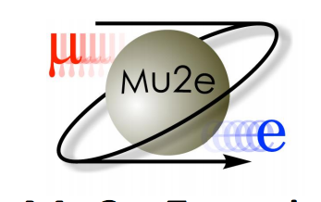
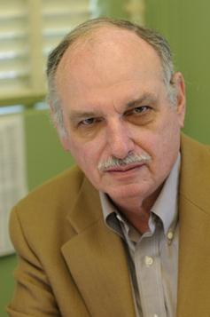

Acknowledgements
Professor David Hitlin
Professor Frank Porter
Jason Trevor, engineer
Jake Kim, graduate student
Summer Undergraduate Research Fellowship Office
California Institute of Technology
Mu2e Experiment
Source: http://www.cacr.caltech.edu/main/?p=221
Source: https://www.mpi-hd.mpg.de/BLV2013/pages/talks/Ehrlich.pdf
Professor David Hitlin
Source: http://www.hep.caltech.edu/~hitlin/

